Slide 1
Job portal documentation

Slide 2


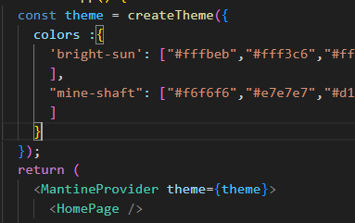
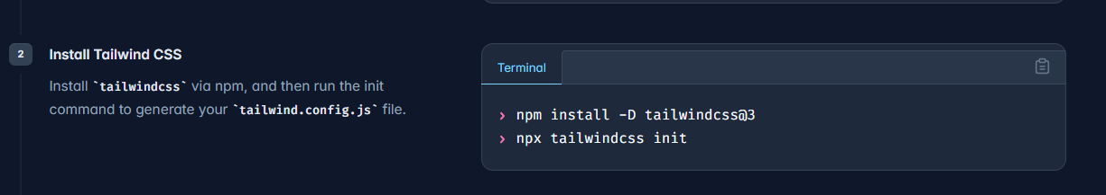


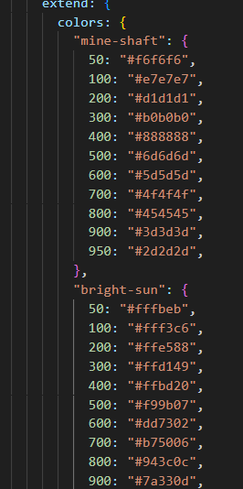
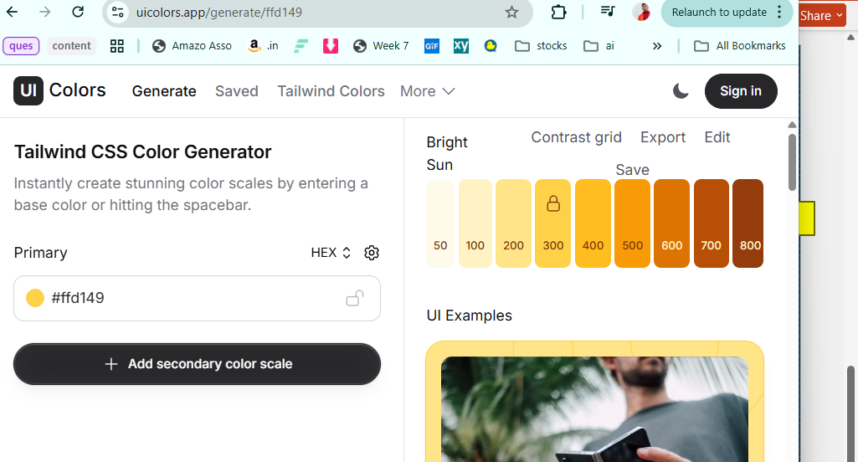
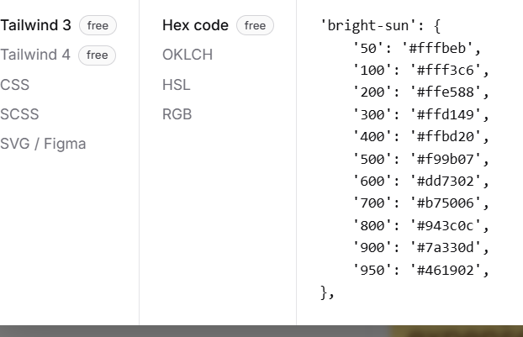
installation
Maintine
app
To use color in maintinrine
tailwind
colors

Slide 3
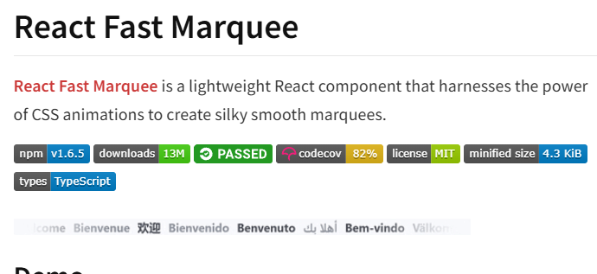

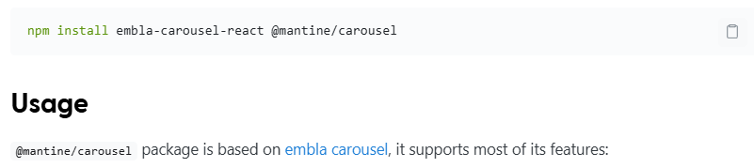
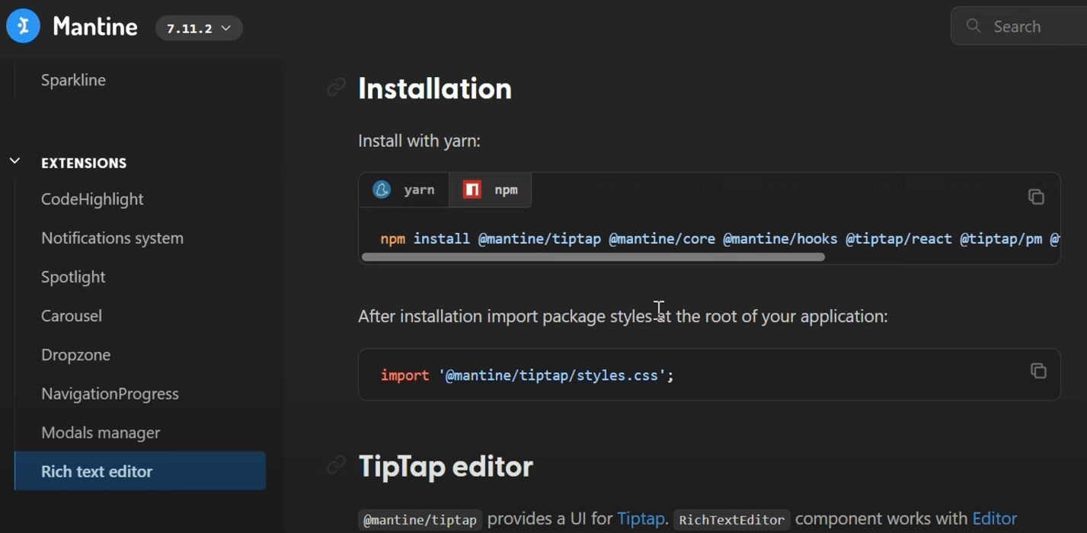
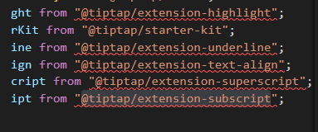

installation
Carusel from Maintine
Install all these Dependencies
Rich editor From Maintie

Slide 4
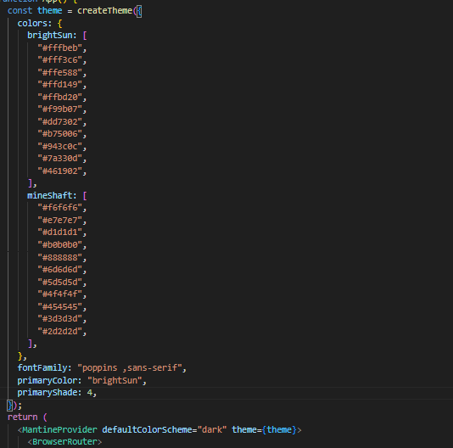

Add color in theme mandine

Slide 5

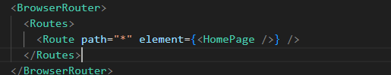

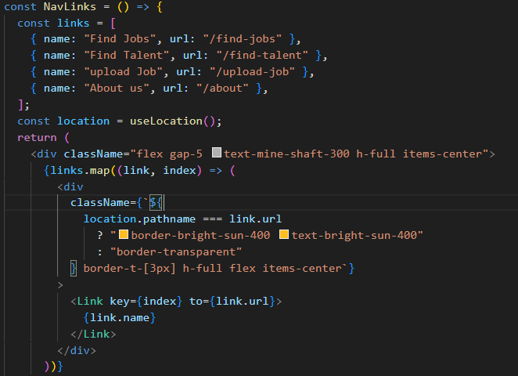
Adding navbar links

Slide 6
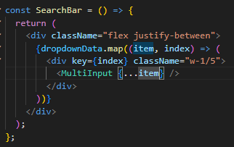

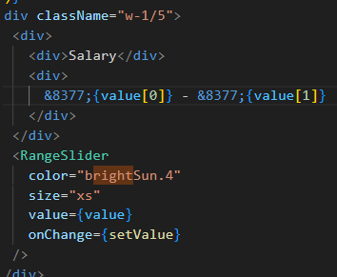
To pass all the values of items as props
Spread Operator passes all the values of DropDown Object into <Tag > as props
How value is set in slider

Slide 7


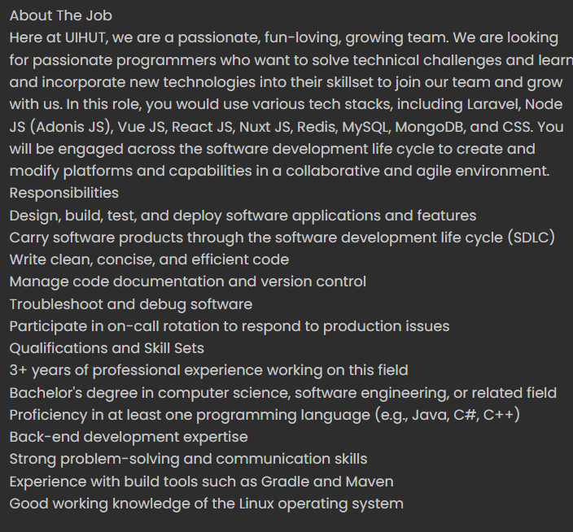
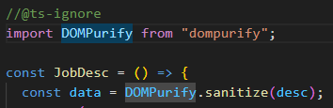
Dangerous set inner html
Html data is sended through Rich Text editor text editor plugin in job post
How to target its data member
To add html data in the web page
It is called dangerous as it allow to inject infected Script to break webpage
To Deal We use Purify library
@ignore to ignore data-type as type script req dt

Slide 8
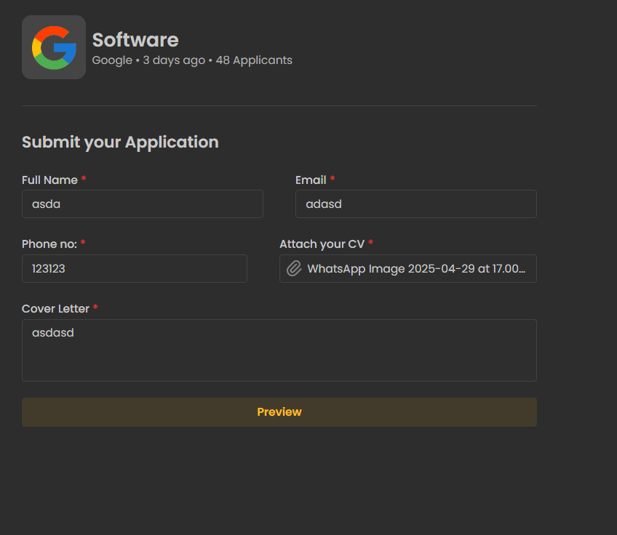
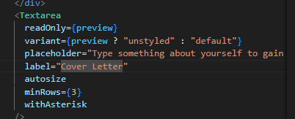

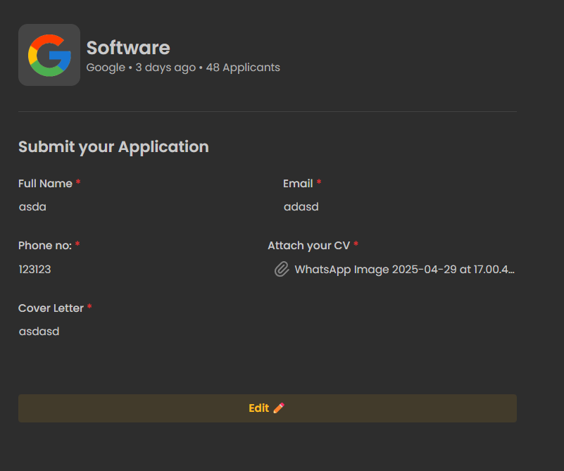
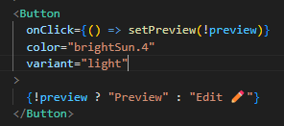
How data preview is careated
If you want to go your window on top when click a button

Slide 9

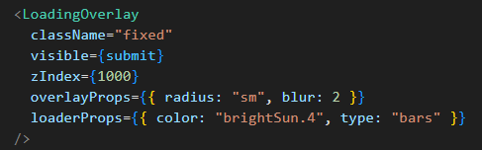
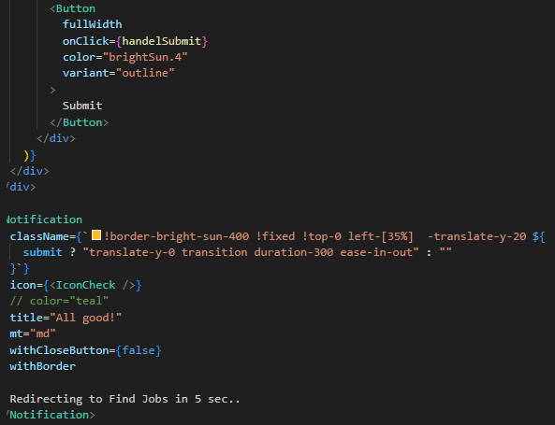
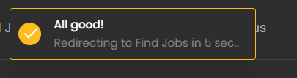
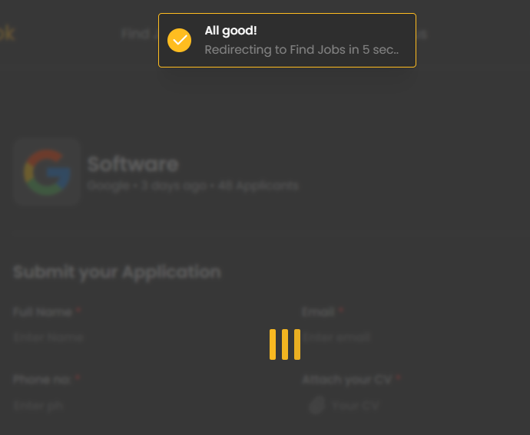
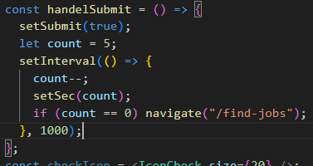

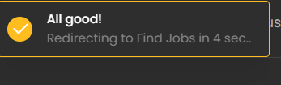

Submit Notification
1
3
Sp that data above below submit redirect notification is not clickable
Logic
1. On click submit btn toggle submit Boolean tru/false 2. Absed on this anivated notification based on yAxis
Let elemnt to show above all
2
And sec count functionality and redirect
Logic
1.Add sec var
2.Reduc Count from 5 by -1 in every 1000 ms
3. If count == 0 redirect to findpjobpage

Slide 10
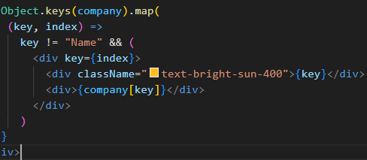
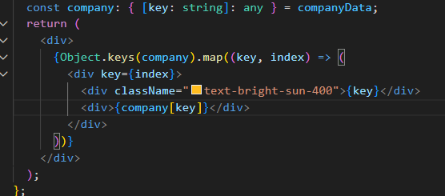
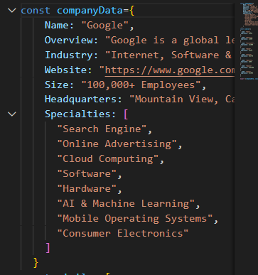
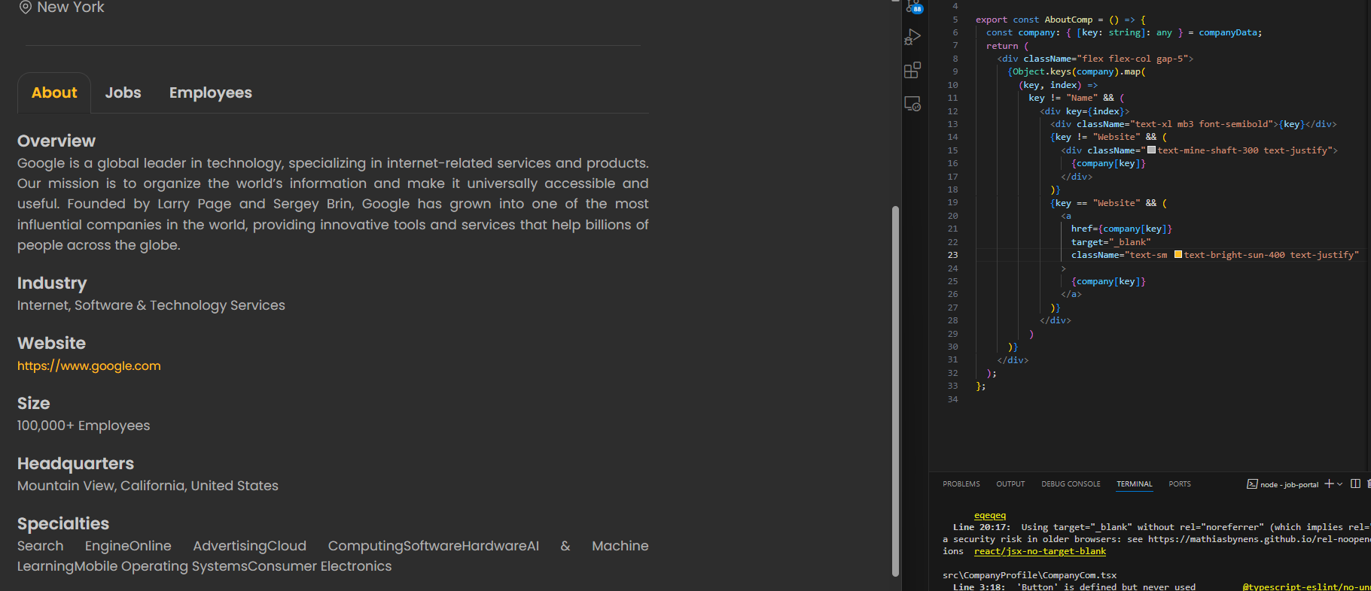
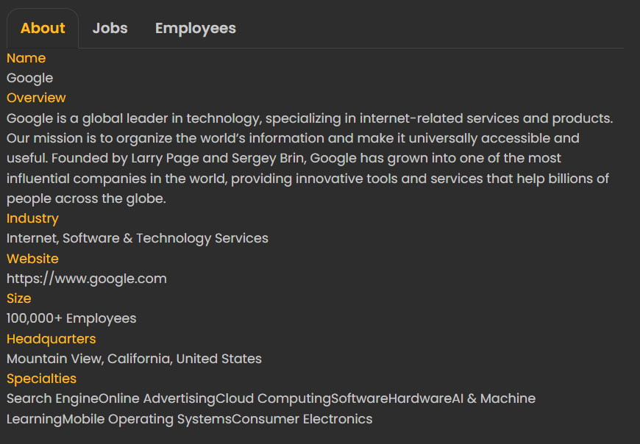
How data is fetched from obj
Adding Functionality
- To remove name component
Its type script so we need to define data type first for obj
-to add website aherf to new blank page
How passing key and ist data -> obj[key]
Logic
If
key == website show normal div else
key != website show link

Slide 11

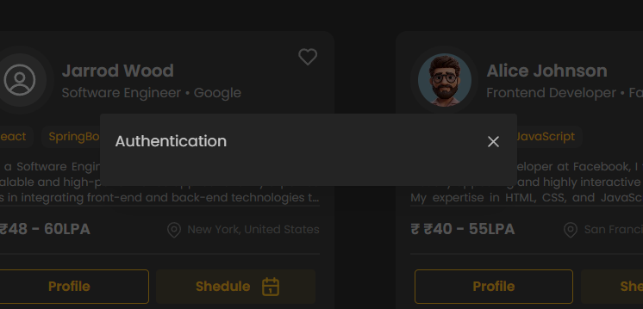

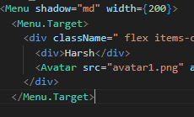
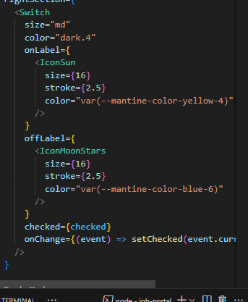
Date input and modal
modal
Modal is pop up form filling window type something
Date Input
MENU
IMPORT ENTIRE MENU
Cut copy avatar from header
Add dark night switch componeet and add controller from mantine menu
Add menu controller to keep menu open

Slide 12

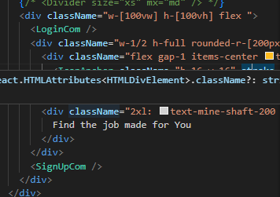
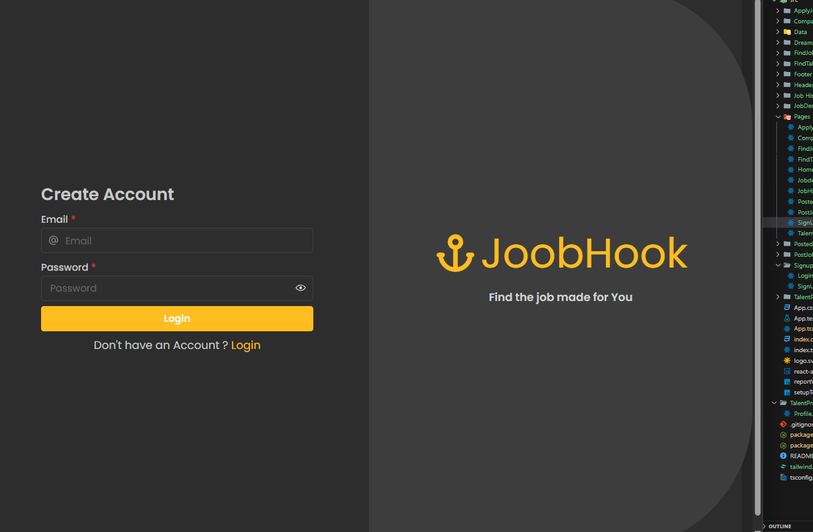
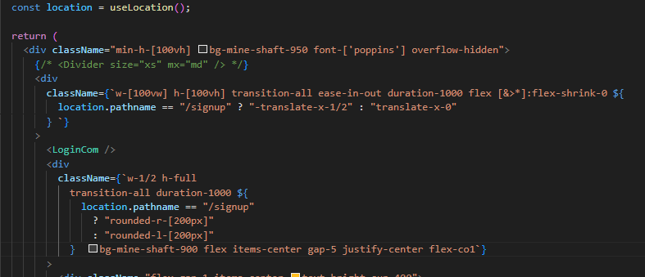
Flex shrink property and login page
Flex default property is that it shrink its content acc to size of page
Making it 0 brink its original size back
2
1
Logic:
Add login page / then shirnk off
Add movement btw page
Add transition and rounded acc to side
3

Slide 13
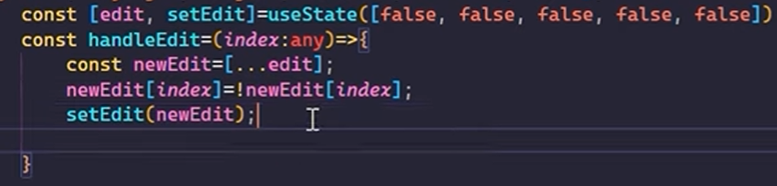



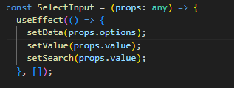
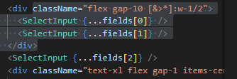
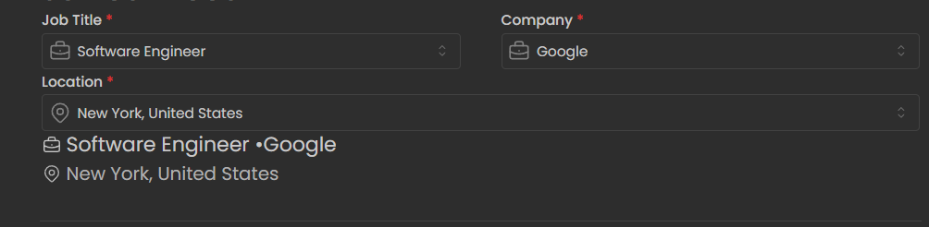
Logic:
Declare use sate edit array
Handel edit function that change trues to false
Enable editing in profile
Props. Value so it grap value from existing data

Slide 14
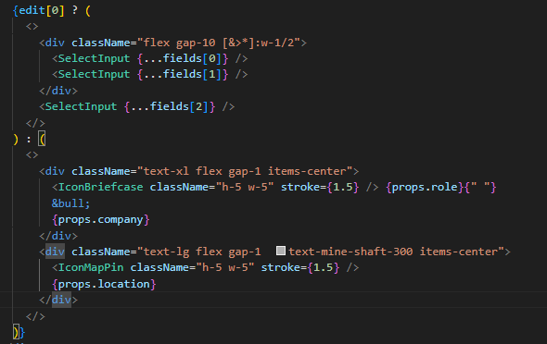
Switching btw edit mode

Slide 15




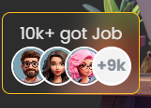

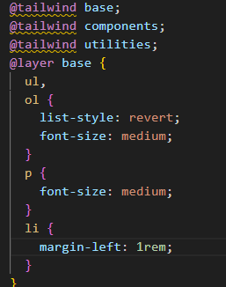
tips
If you r passing data inside tag <>
Then u don’t need to use { } for js
If you want to use loop / map for particular position
To access child in
Tailwind
Acess devcendent
To override the Tailwind default property

Slide 16
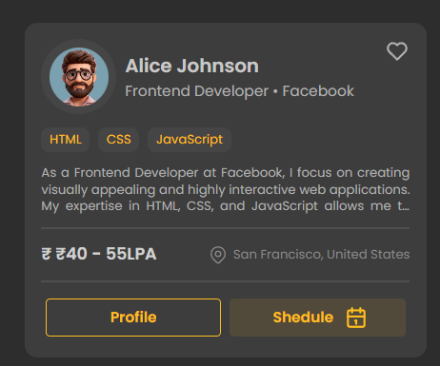
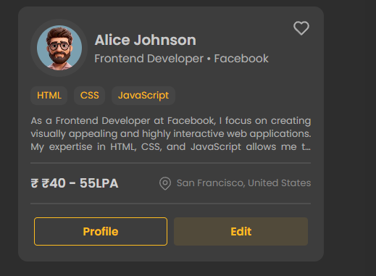

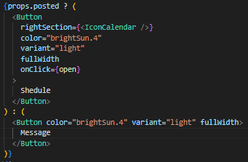

tips
How to pass prop as Boolean to show data according to Diffrent section here: invited Section
To Hide header and Fotter From signup PAge

